Slide 1



Fourth International Conference on (with IEEE Delhi Section as Technical Sponsor) Secure Cyber Computing and Communications “Future-ready Cyber Security: Trust, Intelligence, and Resilience in a Hyperconnected World” [IEEE Conference Record No. #69031] MAY 29-31 2026
Synchronicity Aware Multimodal Deepfake Detection
via Cross-Modal Attention and Bi-Directional Temporal Modeling
[Paper ID – 202, Session – 17]
Presented By:-
Paras Garg
Department of Computer Engineering
National Institute of Technology, Kurukshetra, Haryana-136119, India
ICSCCC’26 | Department of Computer Science and Engineering
Dr B R Ambedkar National Institute of Technology, Jalandhar, Punjab, India

Slide 2


TABLE OF CONTENT
01 Introduction & Motivation
02 Problem Statement
03 Related Work
04 Dataset & Preprocessing
05 Proposed Architecture Overview
06 Video & Audio Stream Architecture
07 Cross-Modal Attention Fusion
08 Experimental Results
09 Comparative Analysis & Ablation
10 Conclusion
11 References
ICSCCC’26 | Department of Computer Science and Engineering
Dr B R Ambedkar National Institute of Technology, Jalandhar, Punjab, India

Slide 3
INTRODUCTION & MOTIVATION
Rise of Synthetic Media
GANs and diffusion models produce hyper-realistic deepfakes manipulating face and voice.
Social consequences: political disinformation, financial fraud, identity theft, non-consensual media.
Limitations of Unimodal Detection
• Visual detectors: spatial artifacts (blinking, lighting, interpolation noise)
• Audio detectors: spectral anomalies and vocoder artifacts
• Hybrid deepfakes (real video + synthetic voice) bypass both unimodal detectors
Key Insight — Biological Synchronicity
In natural speech, facial articulation precedes acoustic emission by ~50 ms.
Synthetic models (trained on independent audio/video objectives) fail to replicate real world deepfakes.
This phoneme viseme temporal gap is the discriminative cue our model exploits.
ICSCCC’26 | Department of Computer Science and Engineering
Dr B R Ambedkar National Institute of Technology, Jalandhar, Punjab, India

Slide 4
PROBLEM STATEMENT
What Are Multimodal Deepfakes?
Videos where audio, video, or both modalities are synthetically generated or swapped.
Four categories: Real-Real | Real-Fake | Fake-Real | Fake-Fake
Why Unimodal Detectors Fail
High-quality synthesis suppresses low-level spatial/spectral artifacts.
No cross-modal reasoning → vulnerable to cross-modal inconsistencies.
Performance degrades significantly under lossy compression.
Research Objectives
Explicitly model audio-visual biological synchronicity for detection.
Handle diverse manipulation types: face-swap, TTS, voice cloning, lip-sync.
Ensure demographic fairness (race, gender) and robustness to compression.
ICSCCC’26 | Department of Computer Science and Engineering
Dr B R Ambedkar National Institute of Technology, Jalandhar, Punjab, India

Slide 5
RELATED WORK
Unimodal Detection
• MesoNet, XceptionNet: visual spatial artifact detection → 76–82% accuracy
• Sabir et al. (2019): recurrent CNN for temporal motion anomaly detection
• Audio detectors: spectral analysis, vocoder artifact identification
Multimodal & Synchronisation-Based
• AVoiD-DF (Yang et al., IEEE TIFS 2023): joint audio-visual learning
• Lips Don't Lie (Haliassos et al., CVPR 2021): generalisable lip-based detection
• AVTENet (Hashmi et al., IEEE TCDS 2025): human-cognition-inspired AV transformer
Cross-Modal Attention Approaches
• Katamneni & Rattani (IEEE IJCB 2024): contextual cross-modal attention for AV detection
• CAMME (Khan et al., 2025): adaptive deepfake detection with multi-modal cross-attention
Gaps Addressed by This Work
• Most prior work lacks explicit biological synchronicity modeling
• Demographic fairness and compression robustness rarely evaluated jointly
ICSCCC’26 | Department of Computer Science and Engineering
Dr B R Ambedkar National Institute of Technology, Jalandhar, Punjab, India

Slide 6
DATASET & PREPROCESSING
Dataset 1 — FakeAVCeleb (Khalid et al., 2022)
• 500 subjects across diverse demographics: African, Asian, Caucasian
• 4 manipulation categories via Faceswap, SV2TTS, Wav2Lip
Dataset 2 — AV-Deepfake1M++ (Cai et al., 2025)
• High-quality TTS and voice conversion attacks with modern generation pipelines
• Representative stratified sample for computational feasibility
Combined Dataset: 28,461 videos | Test set: 4,270 videos
Preprocessing Pipeline
• Video: 16 frames extracted, resized to 224×224, normalised to [0, 1]
• Audio: 16 kHz resample → 3 s clip → Mel spectrogram (128×94) via STFT
• Visual augment: random flip, ±10° rotation, colour jitter, Gaussian blur, random erasing
• Audio augment: time stretch (0.8–1.2×), pitch shift (±2 steps), SpecAugment, BG noise
ICSCCC’26 | Department of Computer Science and Engineering
Dr B R Ambedkar National Institute of Technology, Jalandhar, Punjab, India

Slide 7
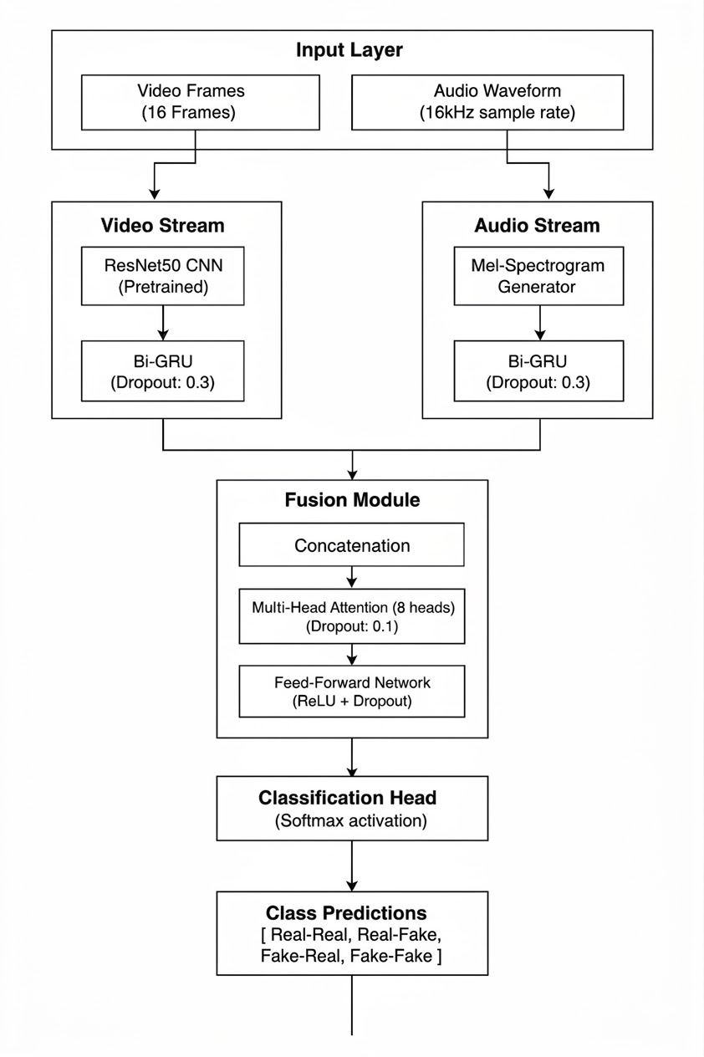
VIDEO & AUDIO STREAM ARCHITECTURE
Video Stream
Backbone: ResNet50 (pretrained, ImageNet)
Frame features: 2048-D embedding per frame (16 frames per video)
Temporal modeling: 2-layer Bi-GRU, hidden size 512 → 1024-D output
Captures: unnatural blinking, head motion anomalies, frame discontinuities
Audio Stream
Input: Mel spectrogram (128 × 94) from STFT (FFT=2048, hop=512, bins=128)
Feature extractor: 4-layer custom CNN (64 → 128 → 256 → 512 channels)
Temporal modeling: 2-layer Bi-GRU, hidden size 256 → 512-D output
Captures: prosodic discontinuities, vocoder artifacts, rhythmic anomalies
ICSCCC’26 | Department of Computer Science and Engineering
Dr B R Ambedkar National Institute of Technology, Jalandhar, Punjab, India

Slide 8
CROSS-MODAL ATTENTION FUSION
Multi-Head Attention Mechanism
• Video (2048-D) + Audio (512-D) → concatenated (2560-D)
• 8-head Multi-Head Attention applied over the combined representation
• Each head learns a distinct aspect of audio-visual temporal correlation
• Dynamically weights modality cues based on cross-modal disagreement level
Why Attention Over Naïve Concatenation?
Naïve concatenation: 84.1% → Cross-modal attention: 92.5% (+8.4%)
• Attention focuses on temporal regions where phoneme–viseme are misaligned
• Learns fine-grained inter-modal relationships, not just global feature statistics
Classification Head (FFN)
• 1536-D → 512-D → 256-D → 4 classes (ReLU + Dropout p=0.3)
• Outputs logits for: Real-Real | Real-Fake | Fake-Real | Fake-Fake
ICSCCC’26 | Department of Computer Science and Engineering
Dr B R Ambedkar National Institute of Technology, Jalandhar, Punjab, India

Slide 9
EXPERIMENTAL RESULTS
Evaluation Setup
• Test set: 4,270 videos (stratified from FakeAVCeleb + AV-Deepfake1M++)
• Metrics: Accuracy, AUC-ROC, F1-Score (Macro), Precision, Recall
Quantitative Performance
Accuracy 92.5%
AUC-ROC 0.940
F1-Score (Macro) 0.900
Precision (Fully Fake) 0.910
Recall (Fully Fake) 0.900
ICSCCC’26 | Department of Computer Science and Engineering
Dr B R Ambedkar National Institute of Technology, Jalandhar, Punjab, India

Slide 10
COMPARATIVE ANALYSIS & ABLATION
Comparison with State-of-the-Art Models
Model Acc. Modality
Proposed Model (ours) 92.5% Video + Audio
Simple Concatenation (ours) 84.1% Video + Audio
XceptionNet 81.9% Video Only
ResNet50 (Baseline) 8.5% Video Only
MesoNet 76.2% Video Only
Key Ablation Findings
Attention vs. concatenation: +8.4% accuracy → cross-modal reasoning is critical
Multimodal vs. best unimodal: +10.2% accuracy → complementary modality cues
ICSCCC’26 | Department of Computer Science and Engineering
Dr B R Ambedkar National Institute of Technology, Jalandhar, Punjab, India

Slide 11
CONCLUSION
1. Novel Synchronicity-Aware Framework
• Dual-stream architecture (ResNet50-BiGRU + CNN-BiGRU) with 8-head cross-modal attention explicitly captures audio-visual biological synchronicity
2. Superior Detection Performance
• 92.5% accuracy and AUC-ROC 0.94 on 28,461-video composite dataset (FakeAVCeleb + AV-Deepfake1M++)
3. Cross-Modal Attention is the Key
• +8.4% gain over naïve fusion; attention focuses on phoneme–viseme temporal misalignments
4. Demographically Fair & Compression-Robust
• < 2% performance variance across race and gender; robustness to H.264 evaluated
5. Future Directions
• Transformer-based temporal modeling | Frequency-sensitive representations | Fairness-aware training
ICSCCC’26 | Department of Computer Science and Engineering
Dr B R Ambedkar National Institute of Technology, Jalandhar, Punjab, India

Slide 12
REFERENCES
[1] Z. Cai et al., "AV-Deepfake1M++: A Large-Scale Audio-Visual Deepfake Benchmark with Real-World Perturbations," arXiv:2507.20579, 2025.
[2] H. Khalid et al., "FakeAVCeleb: A Novel Audio-Video Multimodal Deepfake Dataset," arXiv:2108.05080, 2022.
[3] W. Yang et al., "AVoiD-DF: Audio-Visual Joint Learning for Detecting Deepfake," IEEE TIFS, vol. 18, pp. 2015-2029, 2023.
[4] V. S. Katamneni and A. Rattani, "Contextual Cross-Modal Attention for Audio-Visual Deepfake Detection," IEEE IJCB, 2024.
[5] A. Haliassos et al., "Lips Don't Lie: A Generalisable and Robust Approach to Face Forgery Detection," CVPR, 2021.
[6] E. Sabir et al., "Recurrent Convolutional Strategies for Face Manipulation Detection in Videos," arXiv:1905.00582, 2019.
[7] A. Hashmi et al., "AVTENet: A Human-Cognition-Inspired Audio-Visual Transformer-Based Ensemble Network for Video Deepfake Detection," IEEE TCDS, vol. 17, no. 6, 2025.
[8] N. Khan et al., "CAMME: Adaptive Deepfake Image Detection with Multi-Modal Cross-Attention," arXiv:2505.18035, 2025.
ICSCCC’26 | Department of Computer Science and Engineering
Dr B R Ambedkar National Institute of Technology, Jalandhar, Punjab, India

Slide 13
Thank You!!
ICSCCC’26 | Department of Computer Science and Engineering
Dr B R Ambedkar National Institute of Technology, Jalandhar, Punjab, India

